Slide 1
Prediction of Online Customers’ Purchasing Intention
Team No.8
Xiayi Ye, Chenxing Zhai
Team web page: https://github.com/zcx10025/DM-Project

Slide 2
Introduction
The rapid development of e-commerce is inseparable from the advancement of big data technology. Analysis of customers’ behaviour, purchasing intention and their preference are useful for business decision. For example, after you buy a computer at Amazon, next time you enter Amazon, it will automatically recommend some products related to computer to you, such as keyboard, mouse and so on. After we grasp many big data technologies this semester, we have a new understanding of online shopping. So we choose this topic to explore how big data technology predict online shoppers’ purchase intention. Through this topic, we can not only understand the analysis method of e-commerce from the perspective of a consumer, but also evaluate which consumers have a strong willingness to purchase from the perspective of a merchant.
Our goal is to build several models to predict whether a visit will be finalized with a transaction with this data set. If our model is precision enough, perhaps it can really be used in reality to predict the customers’ purchasing intention. Because this will be a classification problem, so I decide to use confusion matrix to evaluate our model.

Slide 3
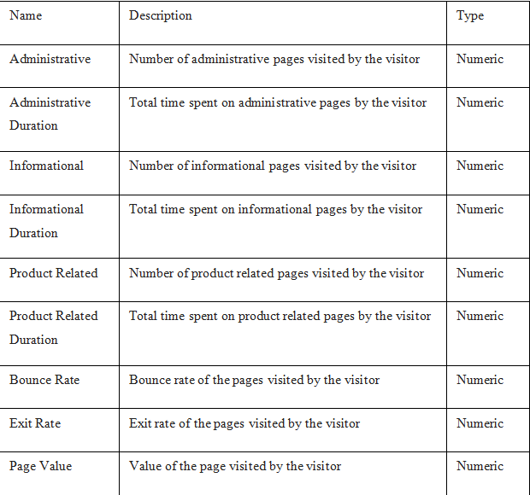
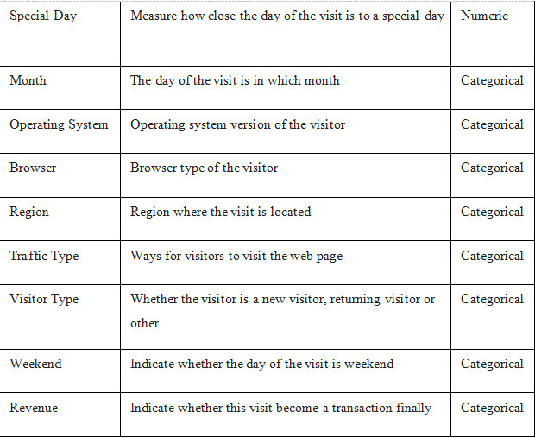
Data set and features
The dataset consists of 10 numerical, 8 categorical attributes and 12,330 rows.

Slide 4
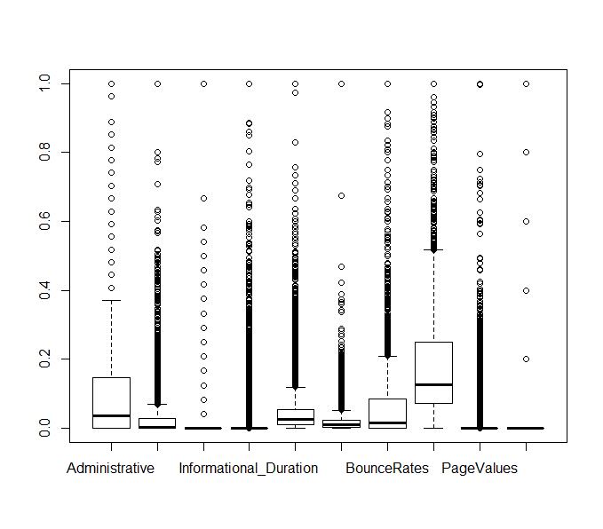
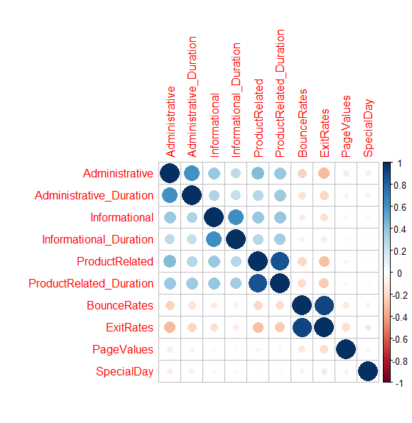
Exploratory Data Analysis

Slide 5
Feature selection
Use function “step”
Best combination: ProductRelated_Duration + ExitRates + PageValues +
Month + TrafficType + VisitorType

Slide 6
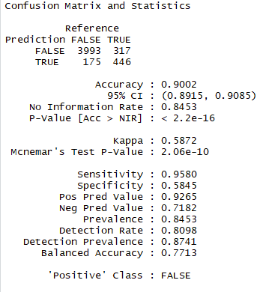
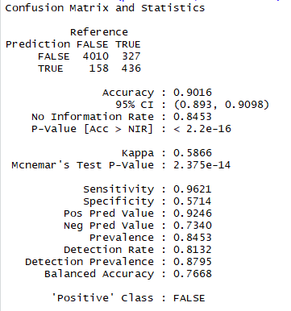
Models and results
All the features are used:
After feature selection:

Slide 7
Future Work
1. Complete the establishment of the neural network model
2. Optimize the parameters of the established model (random forest)
3. Comparative analysis of two models

